Slide 1
Slum Mapping and Household Location Choice
Pranay Gundam
Advisor: Professor Laurence Ales

Slide 2
Presentation Outline
Important definitions
Research question(s) motivation
Exploring the data
Question 1: slum mapping
Question 2: household location choice
Current limitations of research

Slide 3
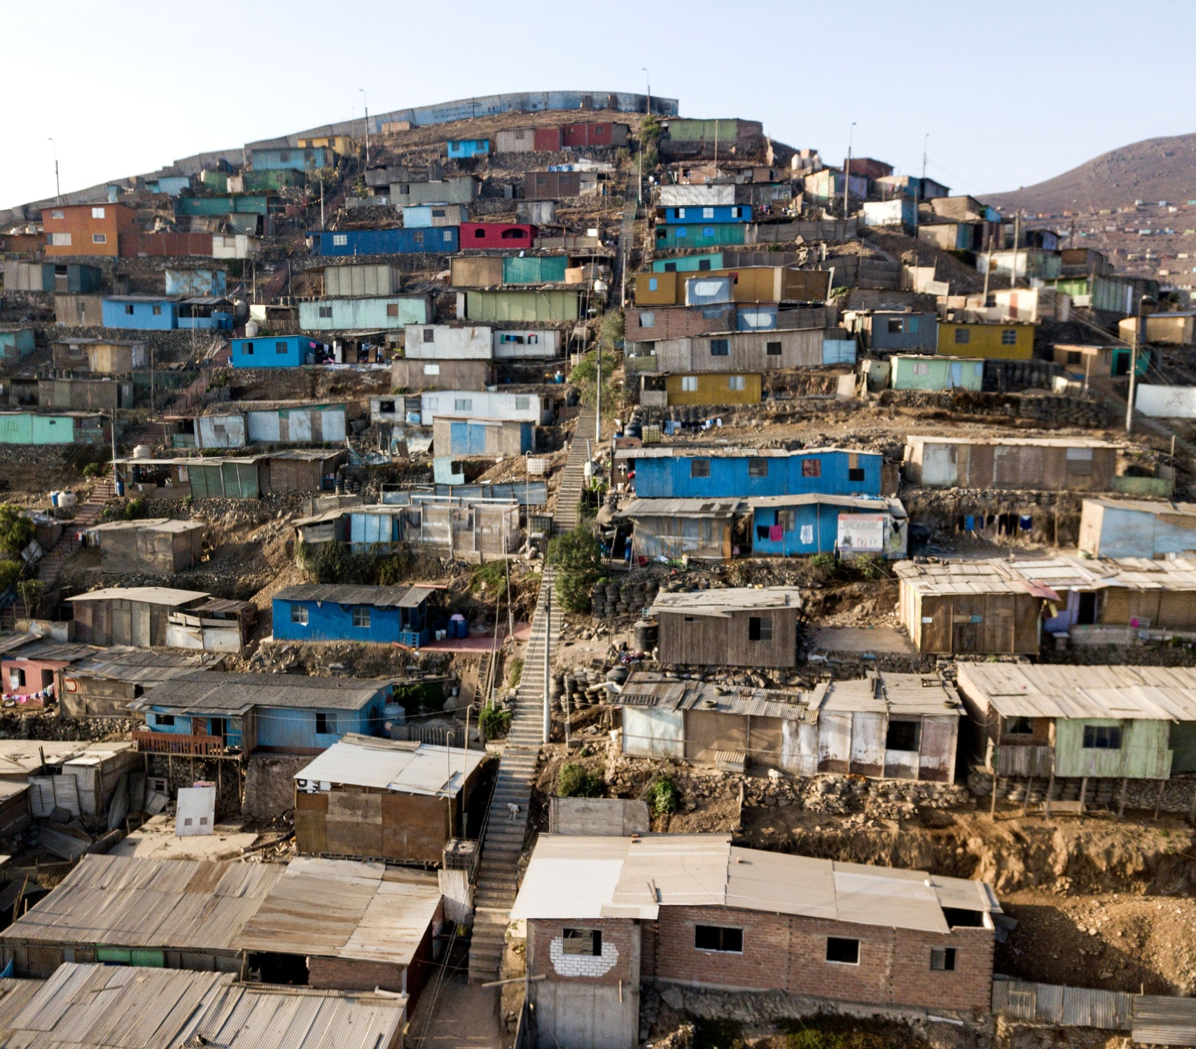
Defining slums
Densely populated
Lack of land ownership
Informal housing units
Lack of hygienic conditions

Slide 4
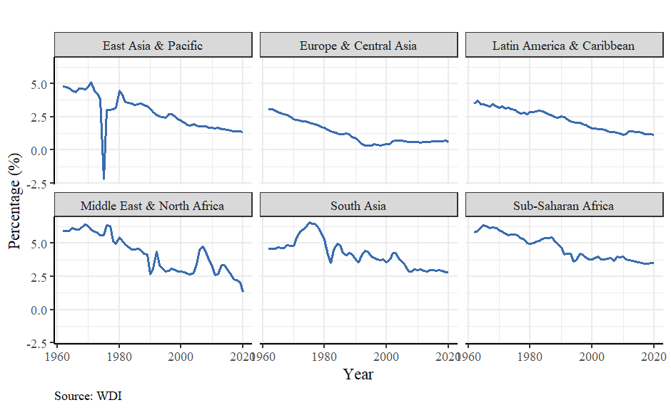
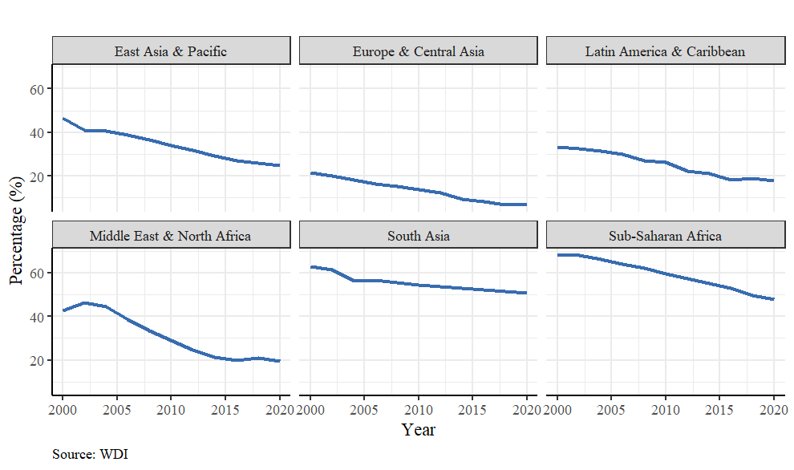
Despite prevailing theory, urban populations and slum populations are growing in opposite directions.
Figure 1: Urban Population growth remains positive
Figure 2: Slum populations as a percentage of Urban population has been declining

Slide 5
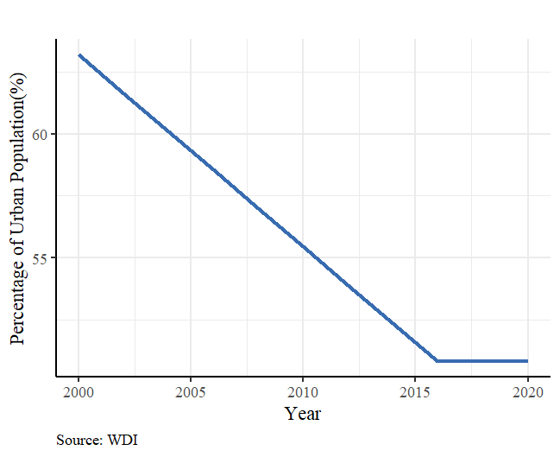
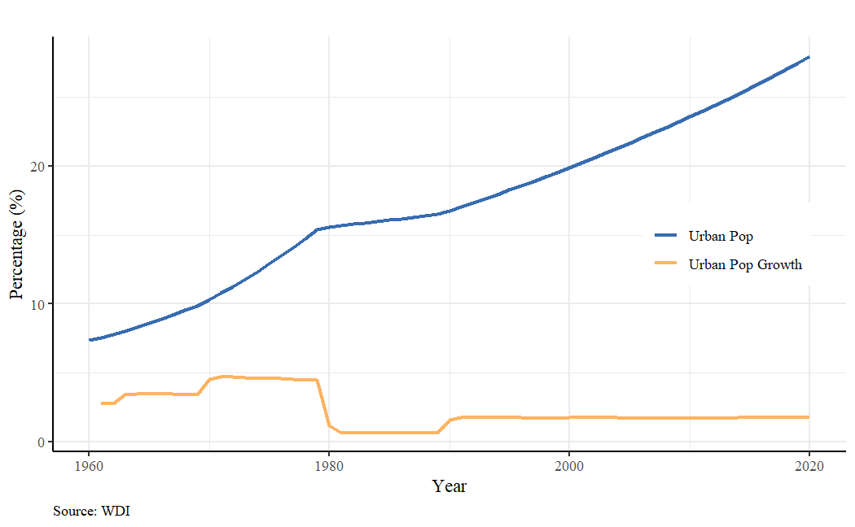
Why does this discrepancy between the theory and data exist?
Figure 3: Urban population trends in Kenya
Figure 4: Slum population as a percent of total urban population in Kenya

Slide 6
Research Question(s)
What is causing this discrepancy between the macro effects and indicators of slum growth?

Slide 7
Research Question(s)
What is causing this discrepancy between the macro effects and indicators of slum growth? Can we understand this issue by developing a micro model?

Slide 8
Research Question(s)
Where is all the data tracking slums?
What is causing this discrepancy between the macro effects and indicators of slum growth? Can we understand this issue by developing a micro model?

Slide 9
Research Question(s)
Where is all the data tracking slums? Can we develop a model to map them using readily available sources of information?
What is causing this discrepancy between the macro effects and indicators of slum growth? Can we understand this issue by developing a micro model?

Slide 10
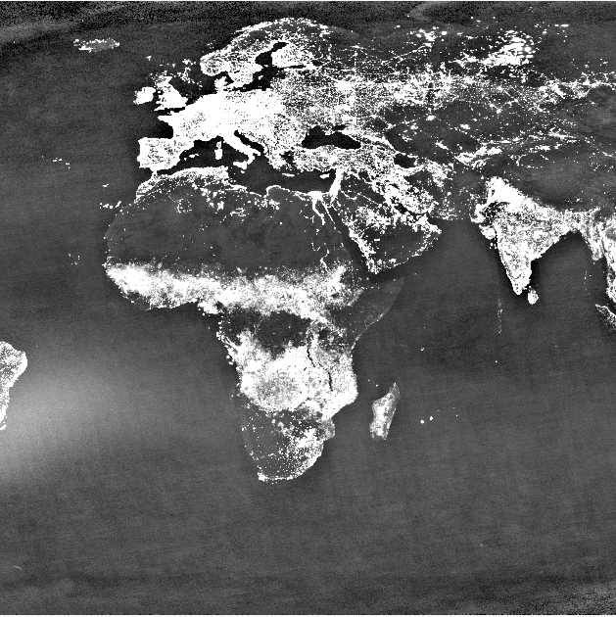
Sources of data
Version 4 DMSP-OLS Nighttime Lights Time Series
World Pop Hub: Population Density Data
Slum Dwellers International
World Bank: World Development Indicators
Numbeo: Rent Characteristics of Countries
Figure 5: Cropped averaged light values in 2008

Slide 11
Processing the data
Slum Mapping
Slum Dwellers International
Version 4 DMSP-OLS Nighttime Lights Time Series
World Pop Hub: Population Density Data
Household Location Choice
World Bank: World Development Indicators
Numbeo: Rent Characteristics of Countries

Slide 12
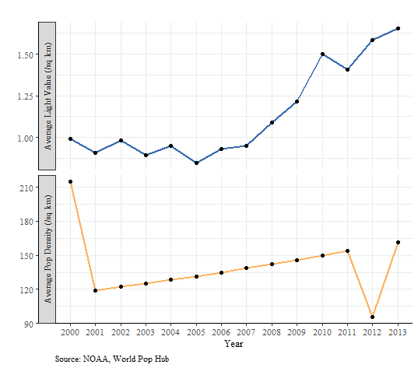
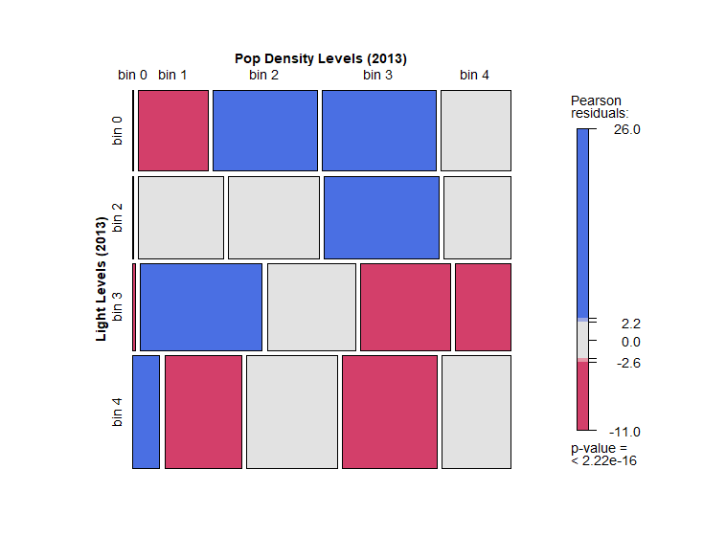
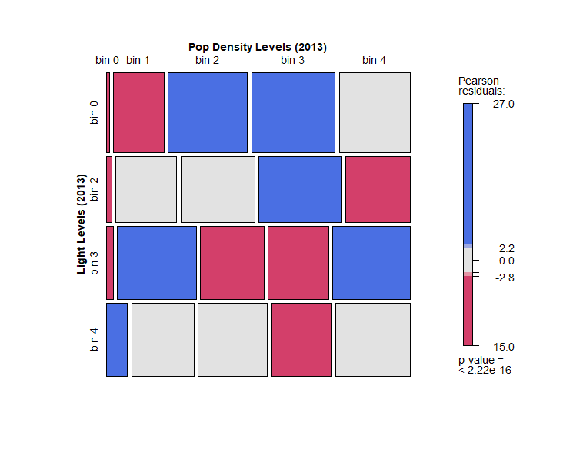
Sanity checks on nighttime light and population density datasets.
Figure 7: Mosaic chart of only slum training examples
Figure 8: Mosaic chart of the total dataset
Figure 6: Averaged population density and nighttime light values over time

Slide 13
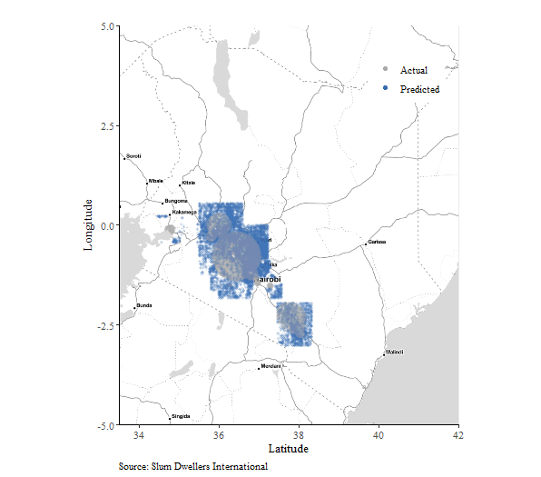
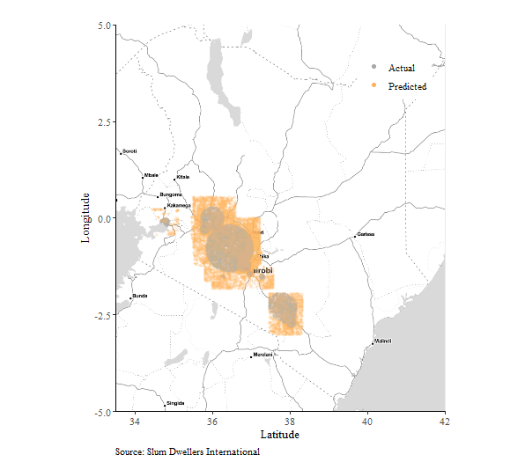
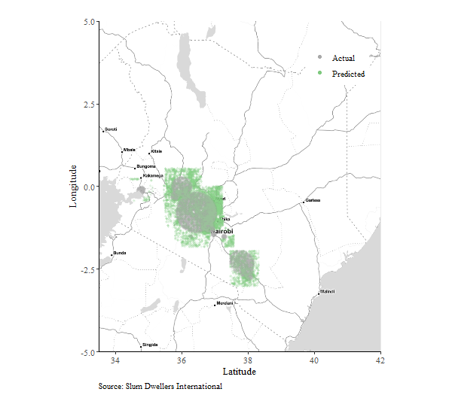
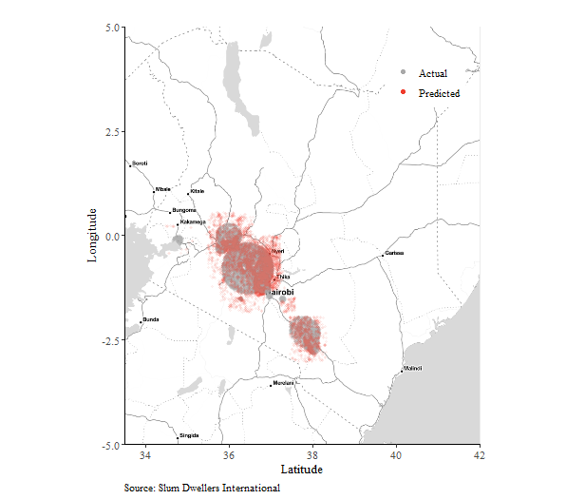
Created four basic classification models
Figure 9: Vanilla Logistic Regression
Figure 10: Bins Logistic Regression
Figure 11: Weighted Logistic Regression
Figure 12: Random Forest

Slide 14
Key takeaways from slum mapping
Hypothesis that slums are more likely to be in locations where light levels are low and population density is high holds.
Locations with low light levels are less likely to be slums regardless of population density.
Better tuned training data is needed to create a more conclusive mapping model.

Slide 15
Specifying the household location choice problem
Binary choice vs multi-choice
Available data resources to calibrate models
Ecological Inference
Requires large assumptions

Slide 16

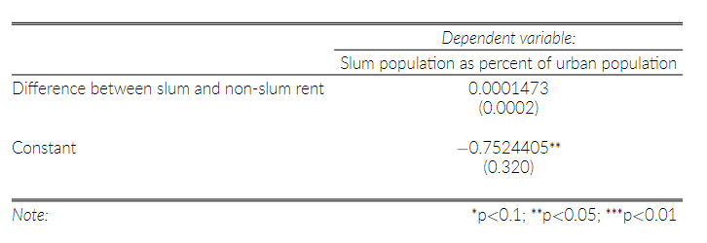


Binary choice model calibrated by aggregate population characteristics.
Table 1: Binary choice model calibrated

Slide 17


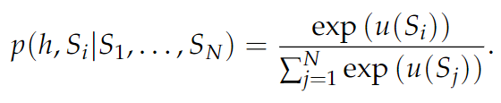


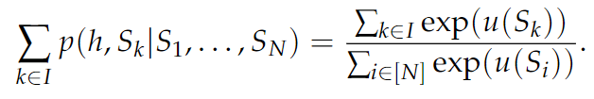
A more fleshed out theoretical model would require even more precise data.

Slide 18
Current research limitations and future work.
Precision and availability of data
Computational resources
Sacrifice model interpretability for predictive power in slum mapping

Slide 19
Questions?

